Slide 1
Designing RF antennas with Ansys HFSS
Huan Q. Bui
ZGS July 14, 2023

Slide 2
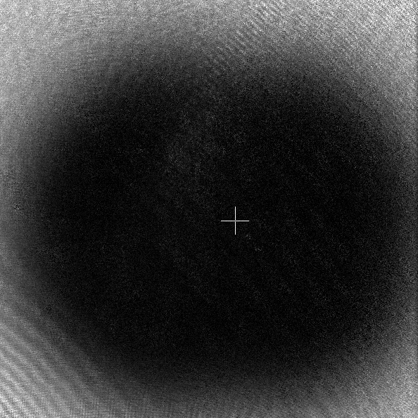
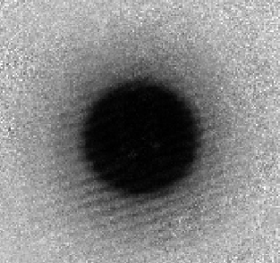
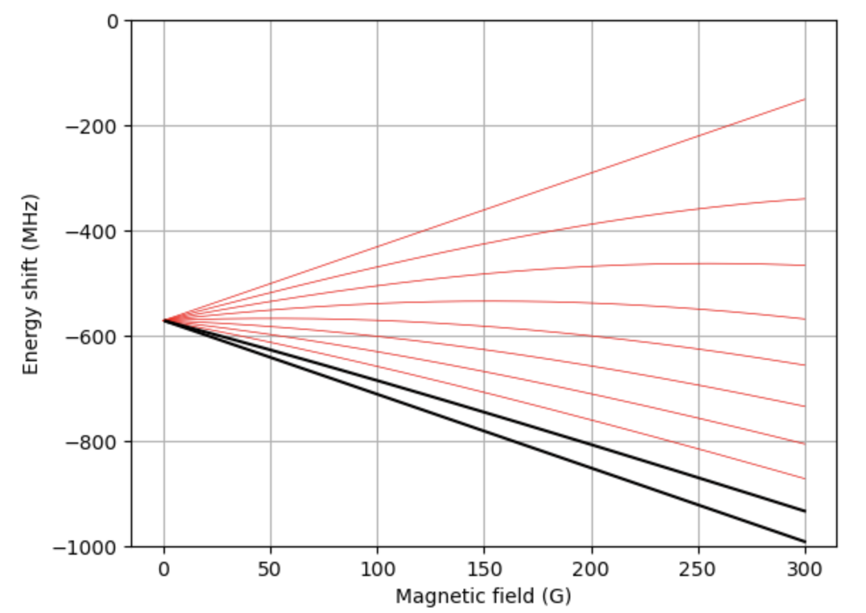
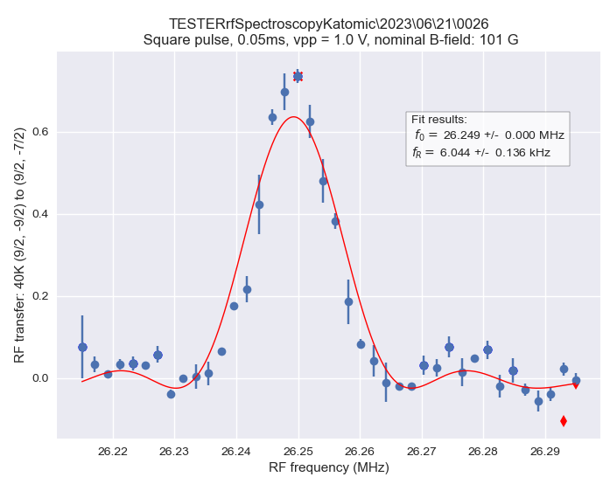
Why RF antennas?
Spin manipulation

Slide 3
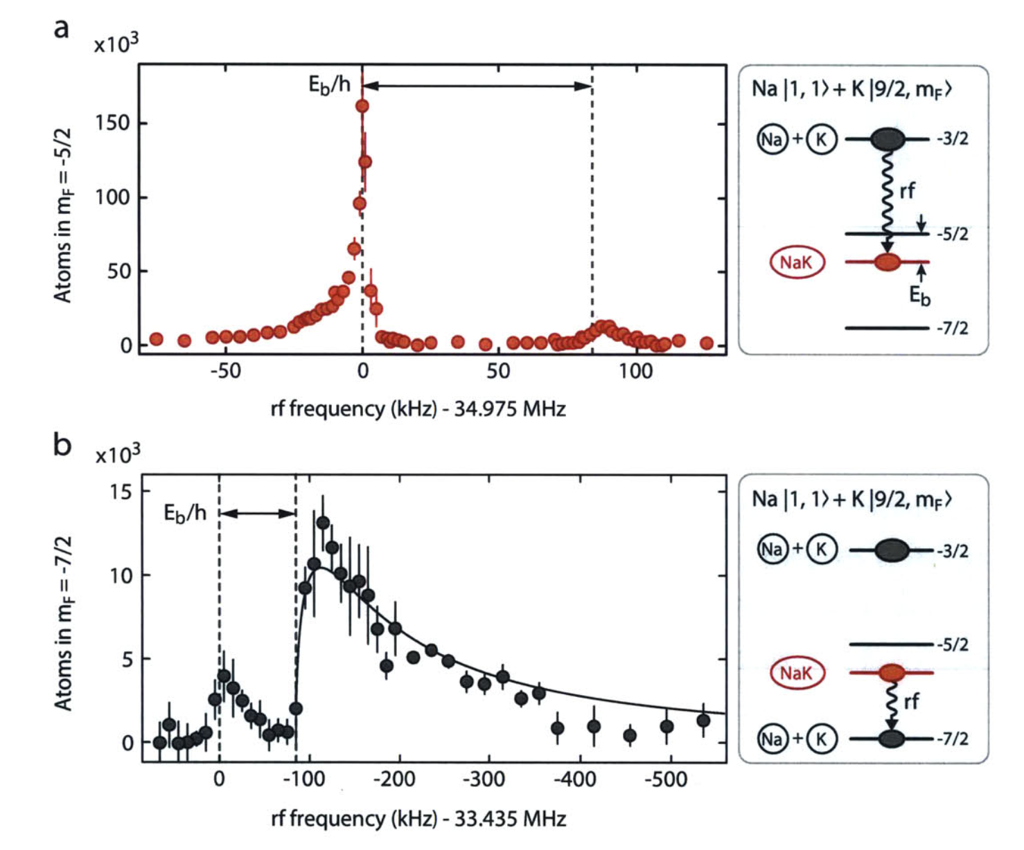
Why RF antennas?
Make/break molecules
Spin manipulation
Cheng-Hsun, W., et al., Phys. Rev. Lett 109 (2012): 085301.

Slide 4
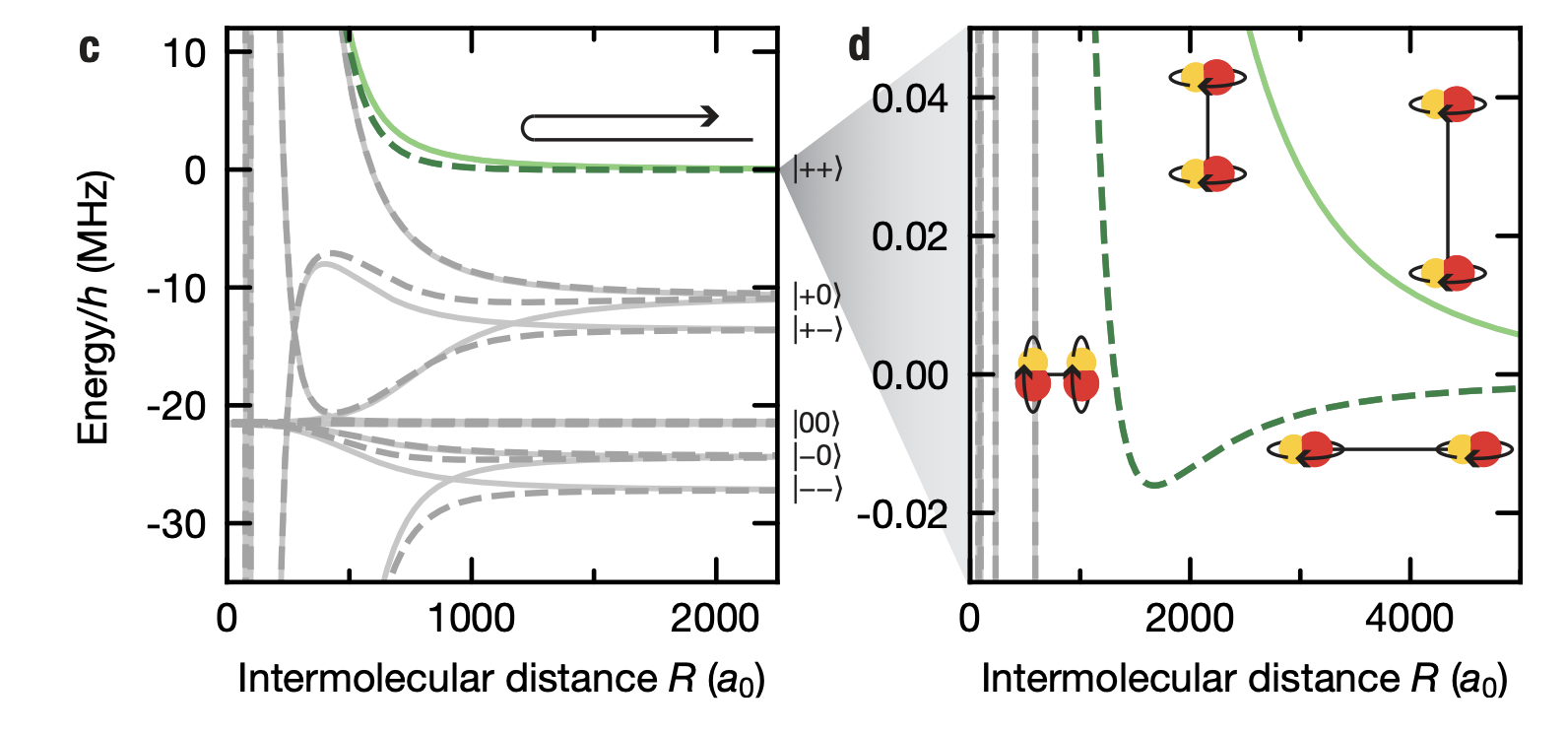
Why RF antennas?
Make/break molecules
Spin manipulation
Cheng-Hsun, W., et al., Phys. Rev. Lett 109 (2012): 085301.
Tune molecular interactions (promised ZGS?)
Schindewolf, Andreas, et al. Nature 607.7920 (2022): 677-681.

Slide 5
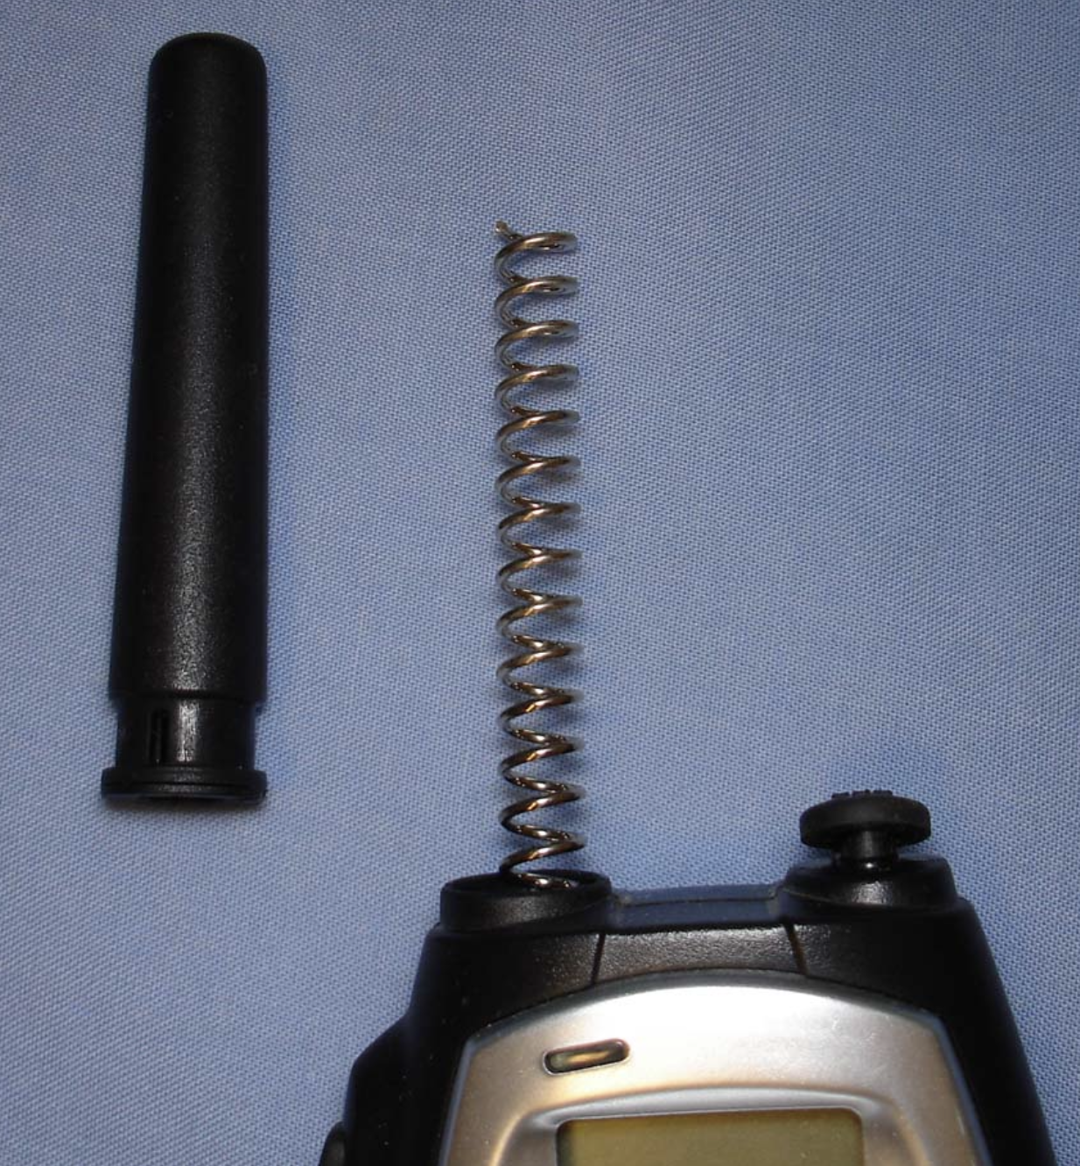
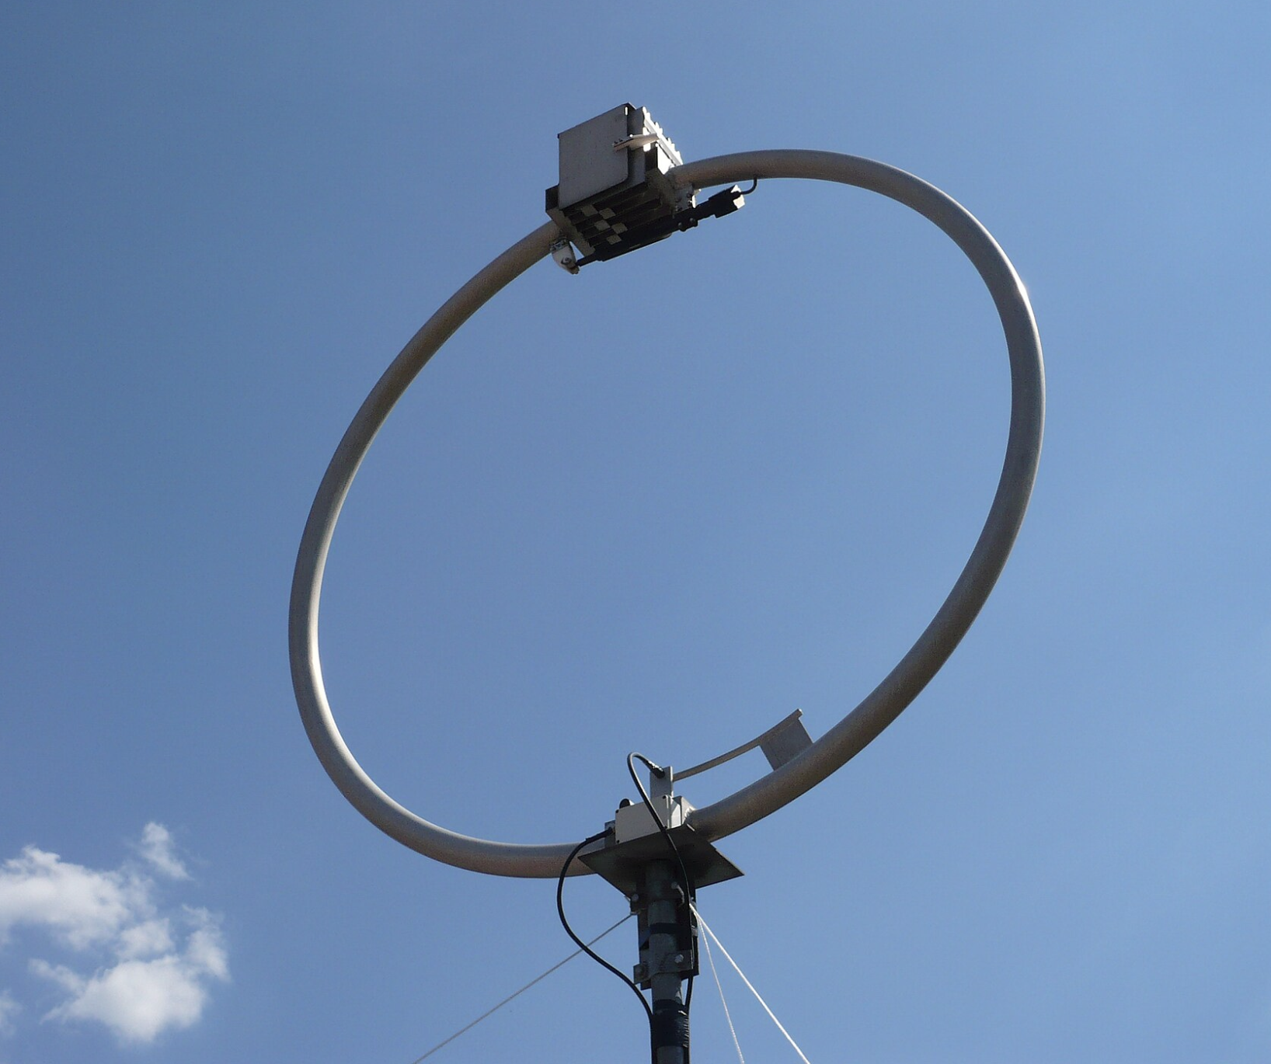
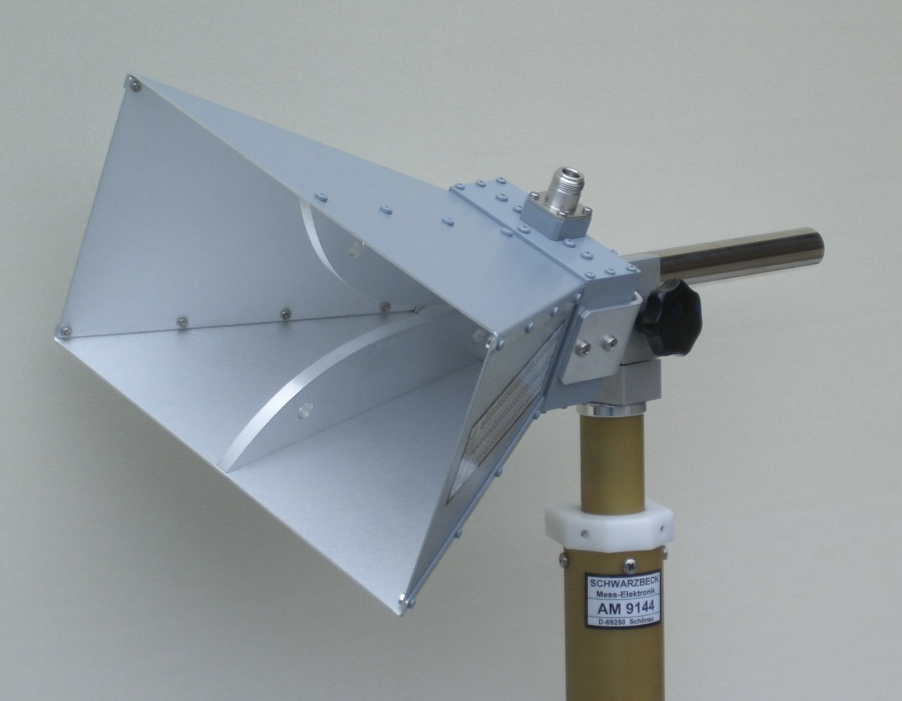
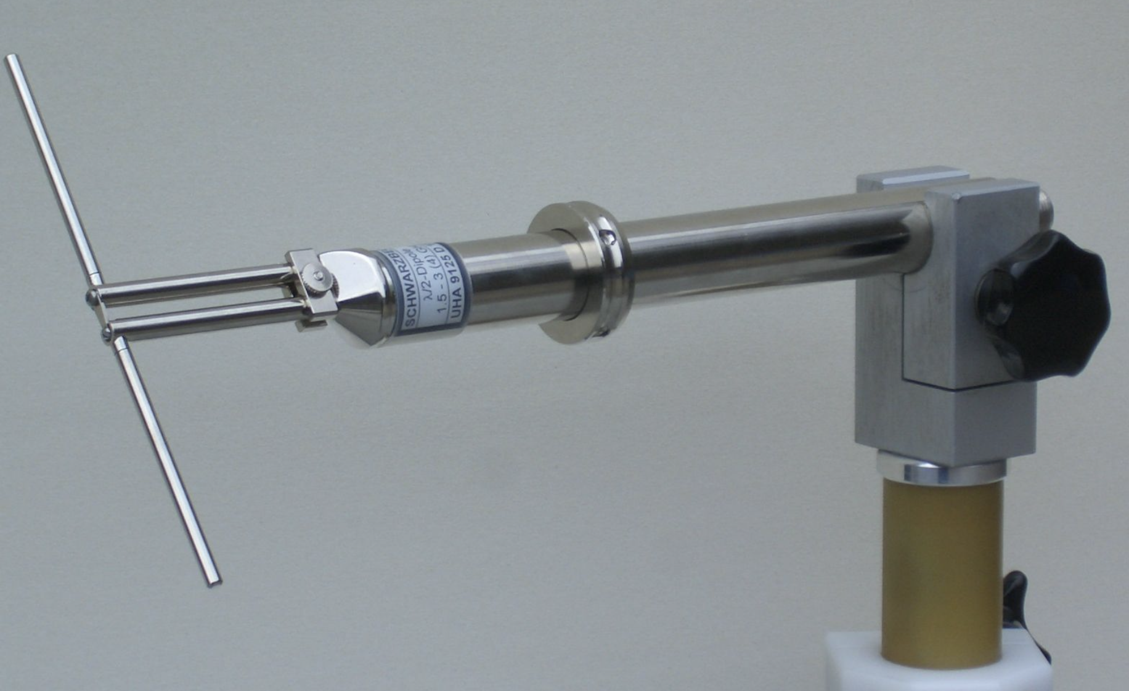
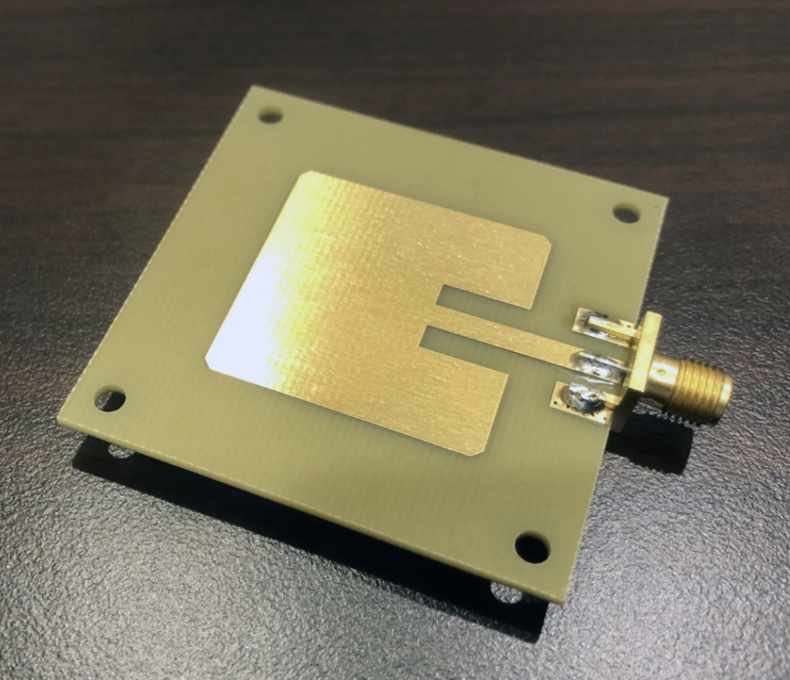
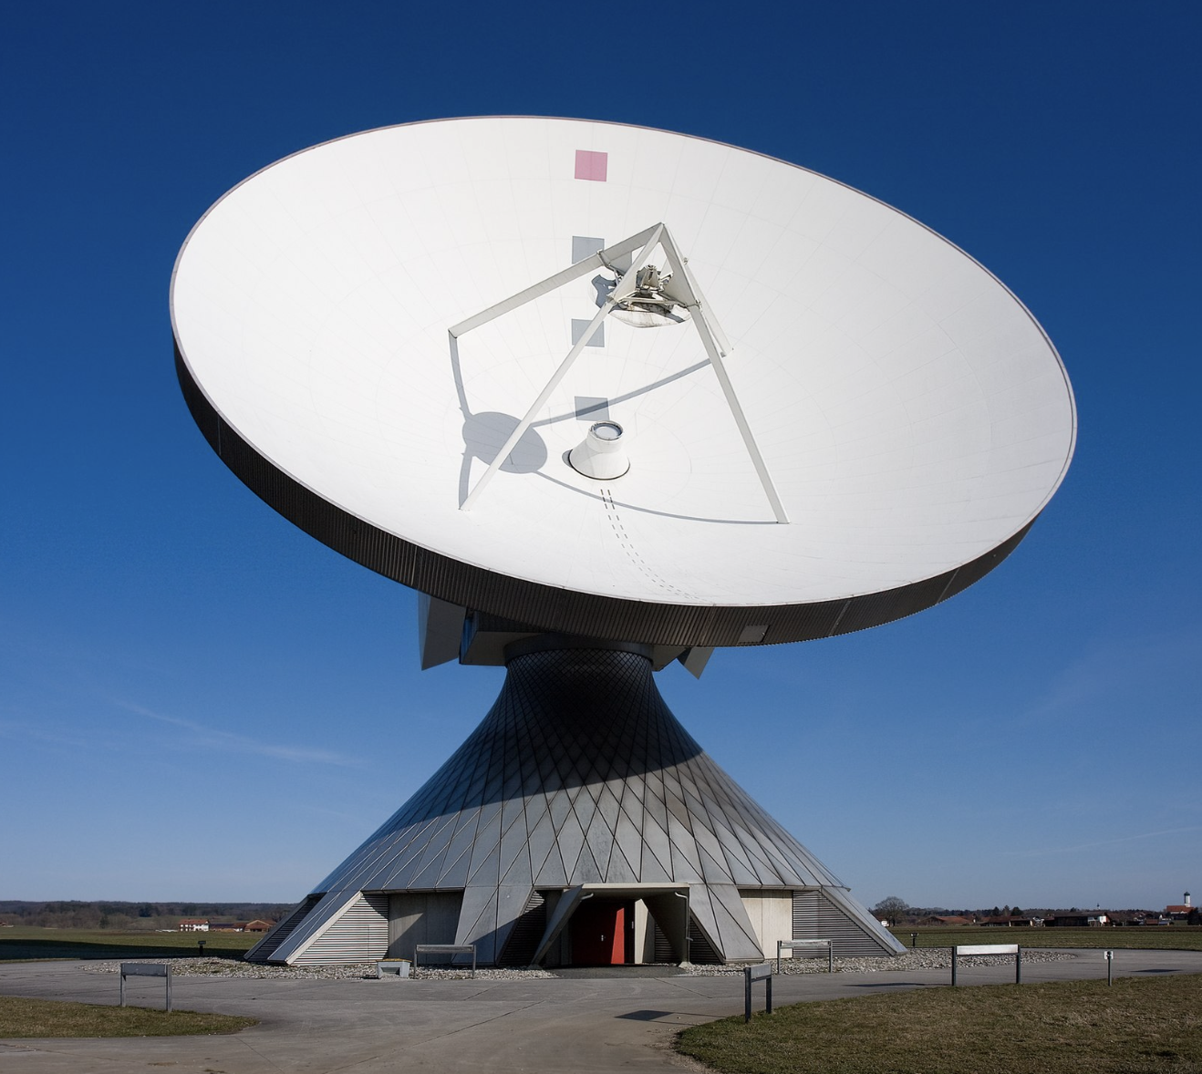
RF antennas in nature

Slide 6
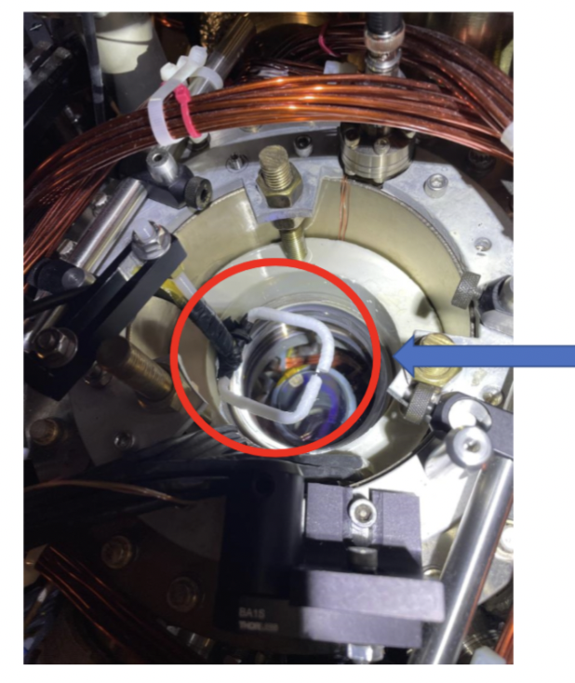
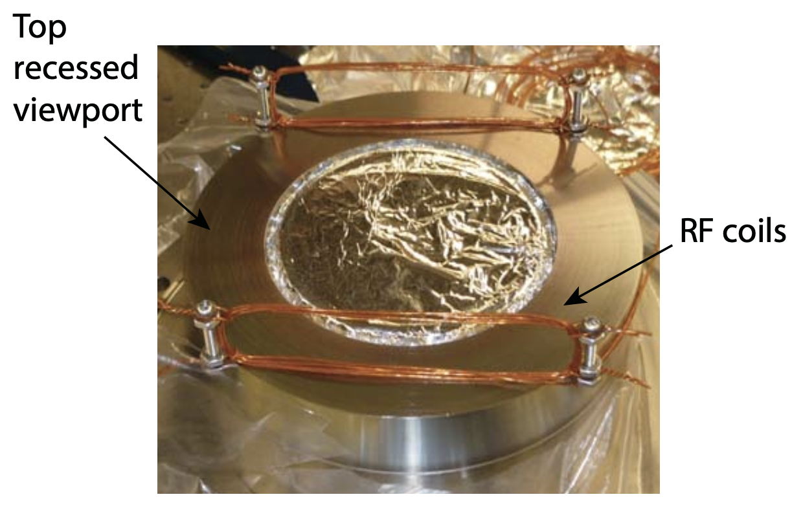
RF antennas in the lab (Fermi1)
F1 outer antenna
CHW thesis
PC: Alex

Slide 7
RF antennas in the lab (Fermi1)
F1 outer antenna
CHW thesis
What do your antennas look like?
PC: Alex

Slide 8
Antenna design considerations
Type & material
Operating frequency range
Polarization of radiation
Antenna matching (“resonance”)
Tunability
Environmental effects
Cost (time and money)

Slide 9
Antenna design considerations
Want:
Simulations before prototyping
Understanding of antenna behavior
Confidence in design
Good selection of parts
Reproducibility
Don’t want:
Design by trial and error
Not foreseeing unexpected behaviors
Voo-doo! Not reproducible
Type & material
Operating frequency range
Polarization of radiation
Antenna matching (“resonance”)
Tunability
Environmental effects
Cost (time and money)

Slide 10
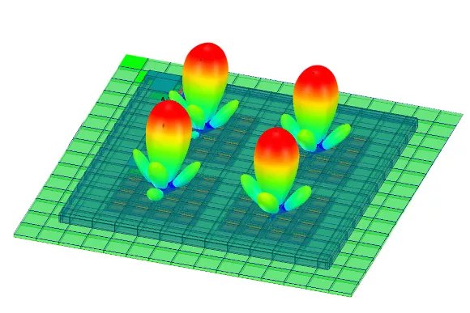
Ansys HFSS
Free*, powerful 3D EM solver
Relatively easy to learn and use:
Watch tutorials (YT/Ansys classes)
Build antenna
Set up solution and solve
Optimize
Alternatives:
COMSOL (very not free, IS&T has no license)
MATLAB (not enough features)

Slide 11
Designing a waveguide antenna with Ansys HFSS in 10 steps

Slide 12
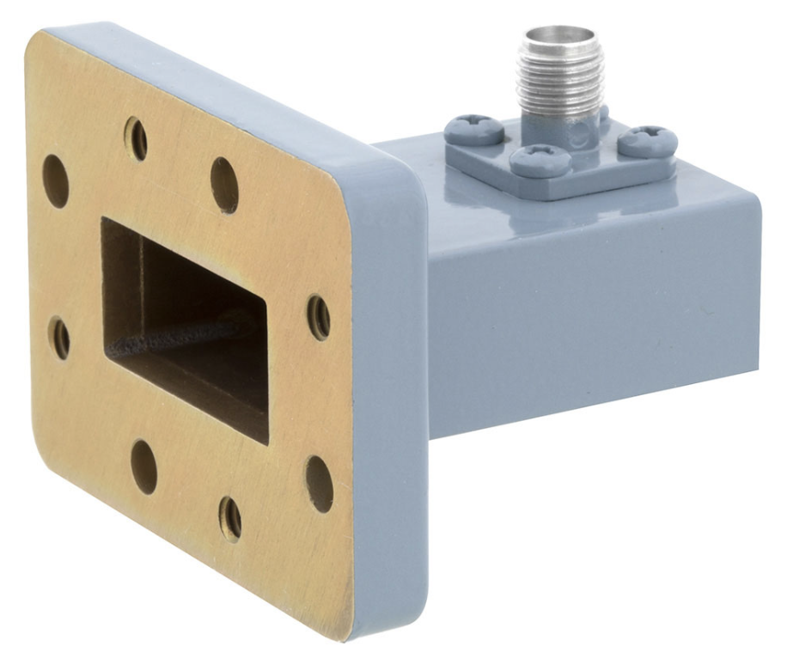
Step 1: Waveguide antenna requirements & dimensions
Operational frequency: 5.640 GHz
Tunable polarization
Radiation with high directivity
Rectangular waveguide antenna

Slide 13
Step 1: Waveguide antenna requirements & dimensions
Operational frequency: 5.640 GHz
Tunable polarization
Radiation with high directivity
Rectangular waveguide antenna
Width: needs cutoff frequency of TE01 mode < 5.64 GHz → a = 33 mm
Length: To be optimized, but set to 58 mm
Feeds: Naively, 2 perpendicular feeds. 13 mm from backwall, 9.5 mm tall
Hole in the backwall for the MOT beam
Inspired by Xing-Yan Chen et al, Nature, volume 614, pages 59–63 (2023)

Slide 14
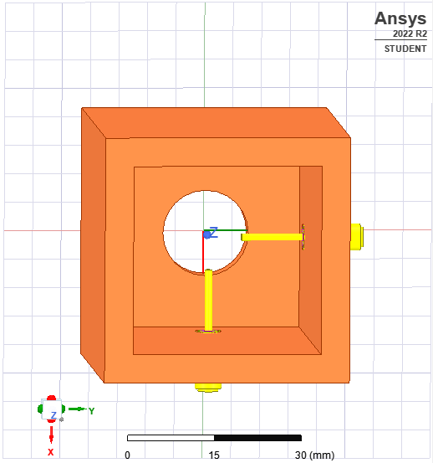
Step 2: Build the antenna in Ansys HFSS
Parametrize!
Feed dimensions: SMA stub connectors
Can specify materials

Slide 15
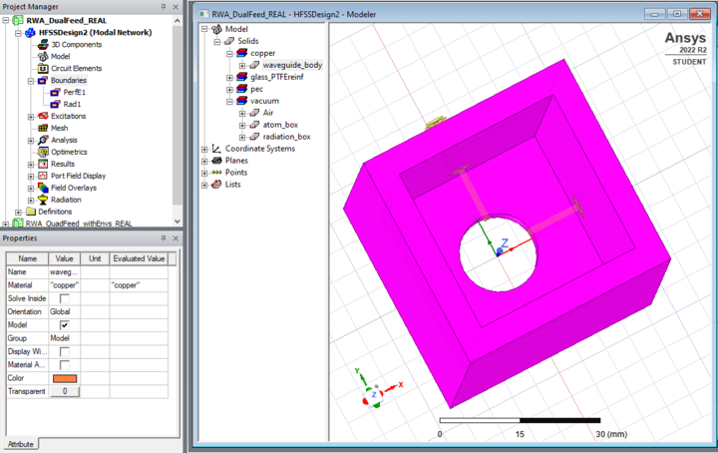
Step 2: Build the antenna in Ansys HFSS

Slide 16
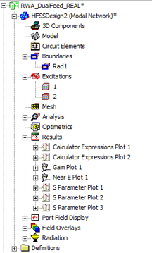
Step 3: Define boundary conditions

Slide 17
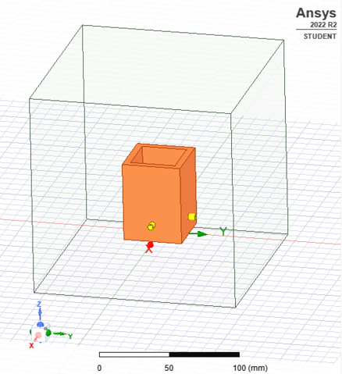
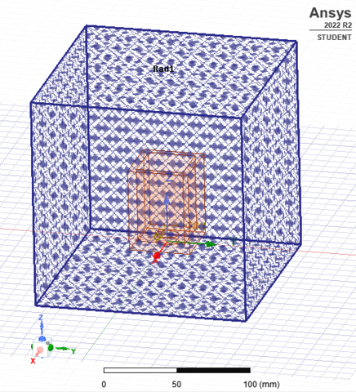
Step 3: Define boundary conditions
Radiation box
Defines FEM volume
Allows energy to radiate out of solution space
Material: vacuum, air, etc.

Slide 18
Step 4: Define excitations

Slide 19
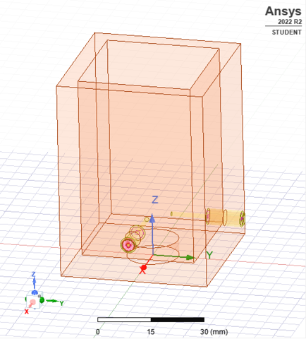
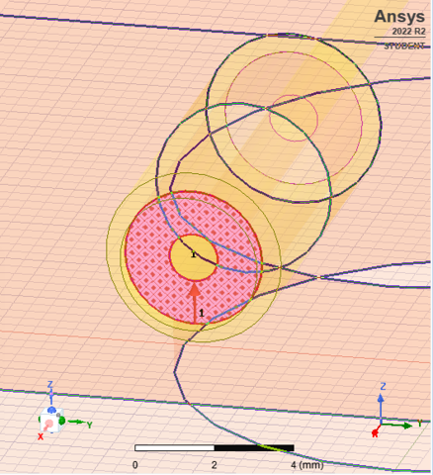
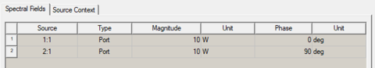
Step 4: Define excitations
… to get antenna’s response: S-parameters, fields, etc. = plugging in the VNA
With multiple ports, can specify:
Relative phases
Relative power (W, dBm, etc.)
Port normalization (Z_{out} of source)
Excitation on coaxial structure

Slide 20
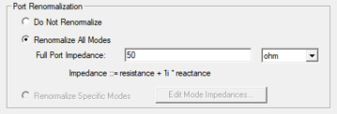
Step 4: Define excitations
Port renormalization:
Enabled: port Z is fixed
Disabled: port Z calculated from design
Good practice: design connectors to specified impedance, but normalize anyway

Slide 21
Step 5: Set up analysis

Slide 22
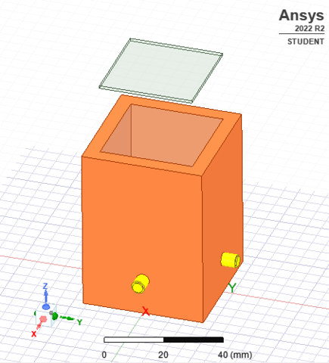
Step 5: Set up analysis
Vacuum box
What to calculate?
Antenna response at different frequencies (S-parameters)
E-field strength & polarization in a region/at a point
Radiation pattern
Directivity
…

Slide 23
Step 5: Set up analysis
What to set up?
Solution frequency
Frequency sweep (range, # of points)
Advanced options:
Calculate derivatives wrt design parameters
Solver (tolerance, # of adaptive solution passes, etc.)
Optimization
…

Slide 24
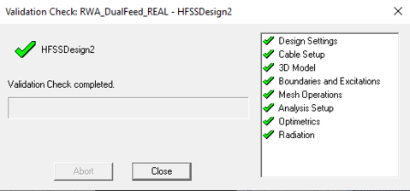
Step 6: Validate and solve

Slide 25
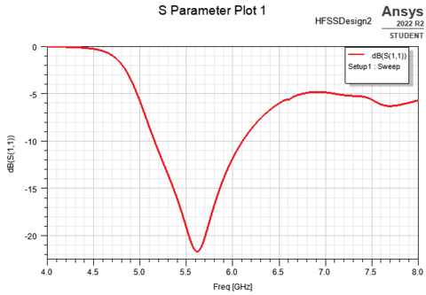
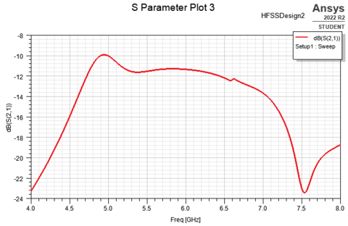
Step 7: View results
S-parameters
S11
S21

Slide 26
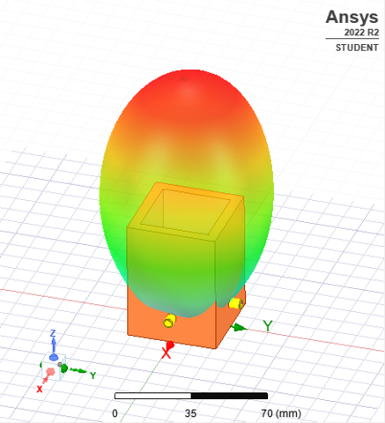
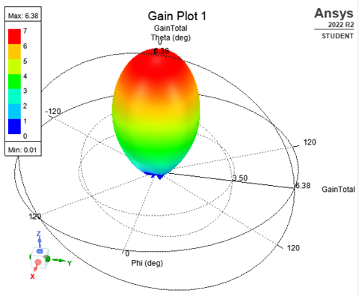
Step 7: View results
3D radiation pattern & directivity

Slide 27
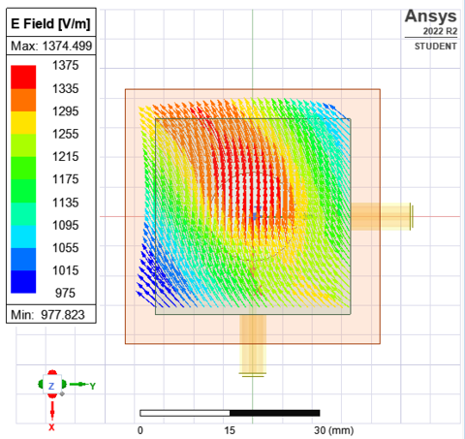
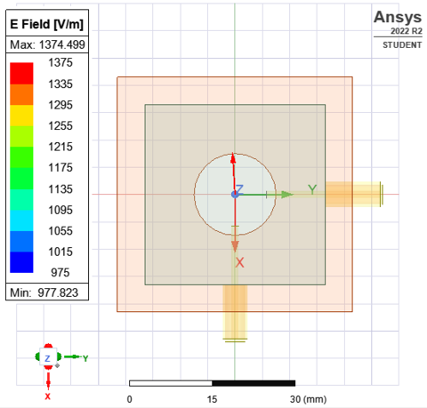
Step 7: View results
E-field strength and polarization

Slide 28
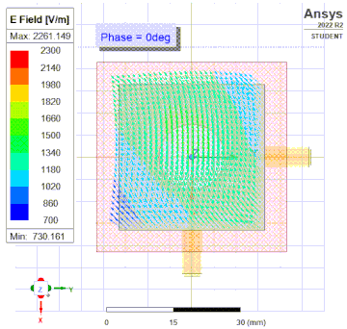
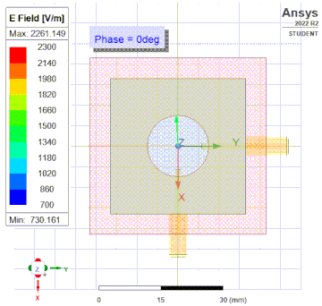
Step 7: View results
E-field strength and polarization

Slide 29
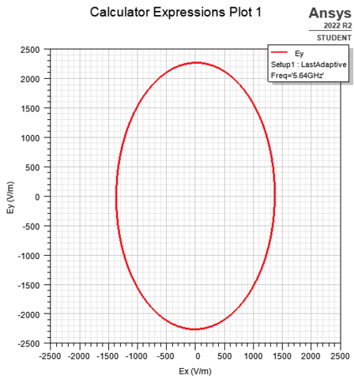
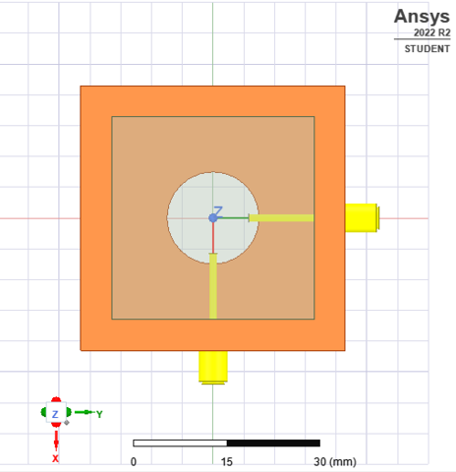
Step 7: View results
E-field strength and polarization

Slide 30
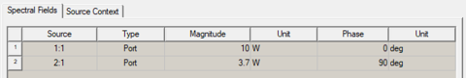

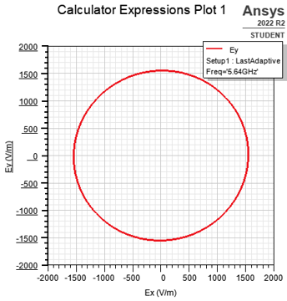
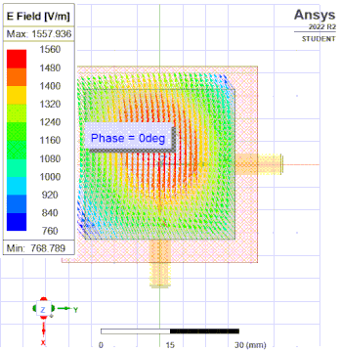
Step 8: Study
Counter-intuitive power ratio
Polarization tuning

Slide 31
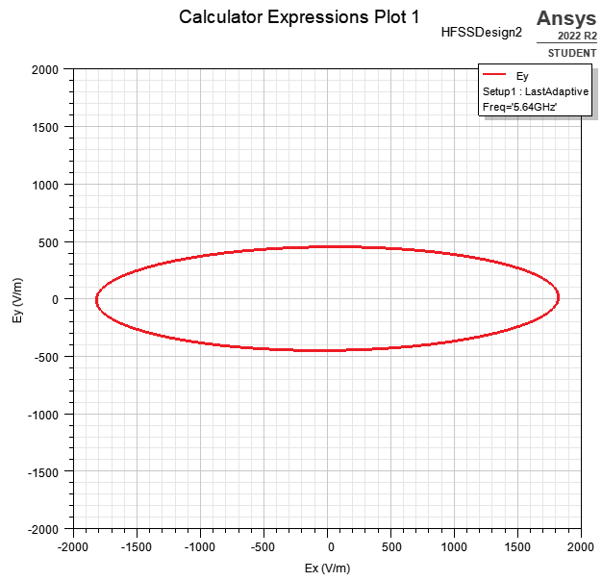
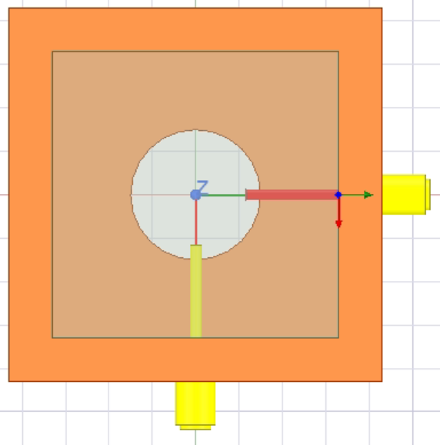
Step 8: Study
Only one probe feed
→ expect linear polarization
Something wrong with the model?
Where does Ey come from?
…
x
y

Slide 32
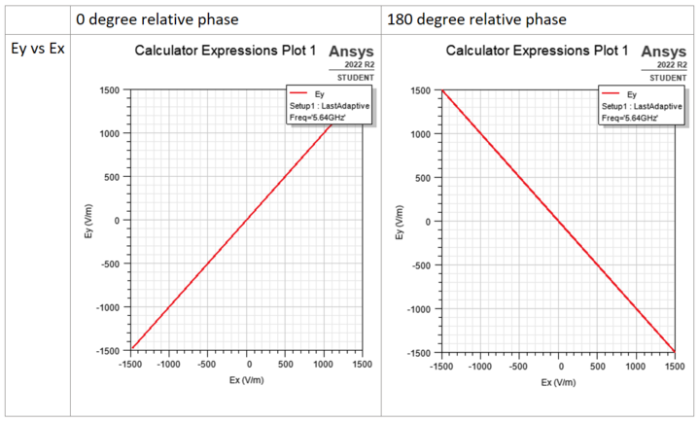

Step 8: Study
Something wrong with the model?
Test 1: make diagonal polarizations
as expected

Slide 33
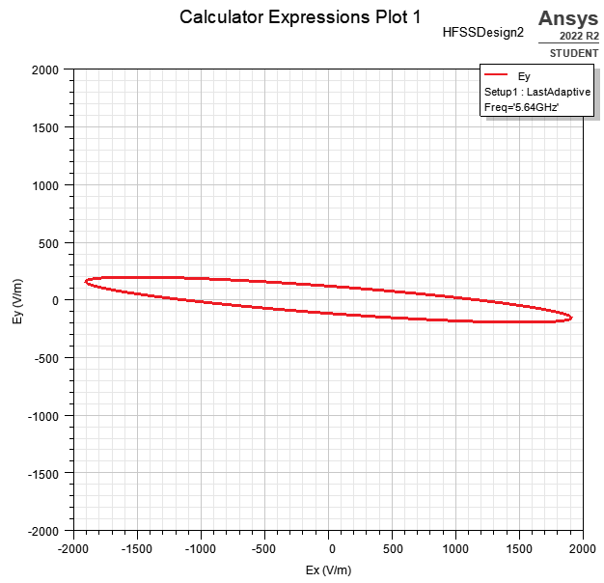
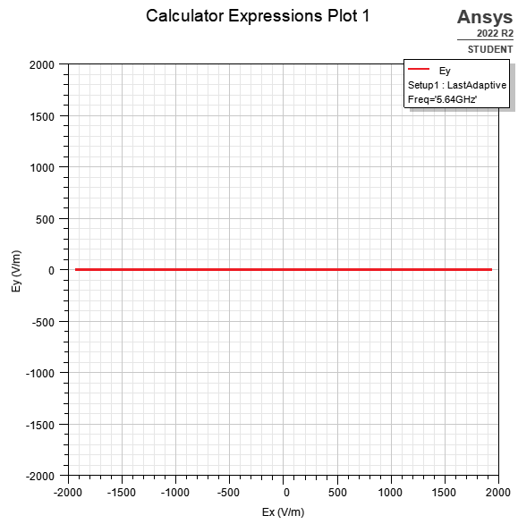
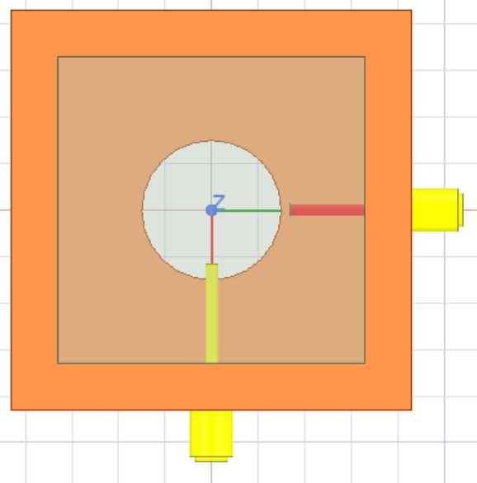
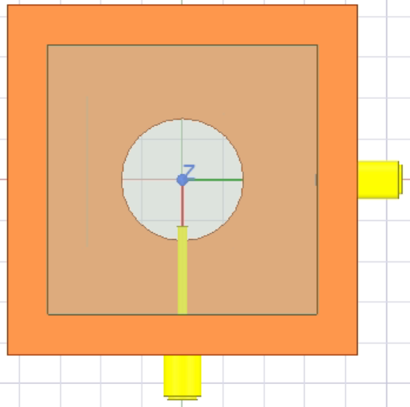
Step 8: Study
Something wrong with the model??
Test 2: Effect of inactive probe feed on active probe feed
Likely the antenna’s geometry
x
y

Slide 34
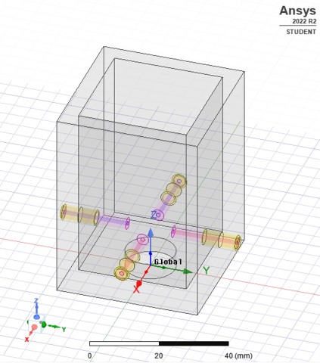
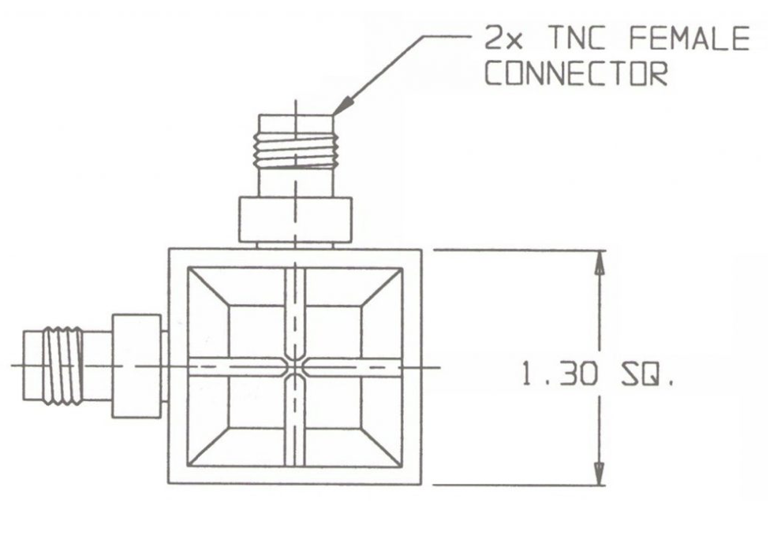
Step 8: Study
Something wrong with the model??
Test 3: Restore the antenna symmetry by adding probe feeds
Inactive
It is the antenna’s geometry
Dual-polarized commercial antenna
Active

Slide 35
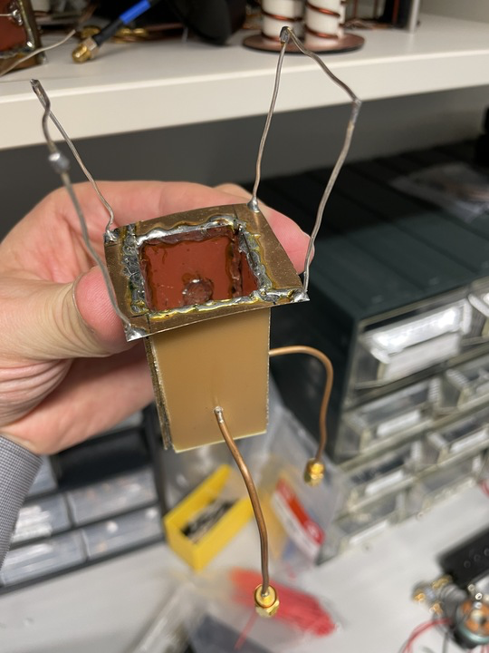


Aside: A real antenna
Power ratio for CP = 1 : 2
pc: Munich group & Martin

Slide 36


Aside: A different antenna
46 MHz Rabi frequency with NaCs, or E = 33 kV/cm
SW’s cloverleaf antenna

Slide 37

Step 9: Optimize/Revise
Can we get the best of both worlds??
+

Slide 38



Step 9: Optimize/Revise
Four-feed design:
Intuitive and easy polarization tuning
High directivity
High reproducibility
More E for less $$$
Standard SMA stub connectors

Slide 39


Step 9: Optimize/Revise
S-parameters

Slide 40


Step 9: Optimize/Revise
Radiation pattern & directivity

Slide 41


Step 9: Optimize/Revise
E-field strength and polarization

Slide 42




Step 9: Optimize/Revise
E-field strength and polarization
E ~ 30 V/cm
Intuitive polarization tuning!

Slide 43




Step 9: Optimize/Revise
Environmental effects? Say… a chunk of metal is nearby?
Many properties are modified: resonance, directivity, max E, etc.
E = 22 V/cm

Slide 44


Step 9: Optimize/Revise
Other things to consider:
Material
Cost/ease of production
Ease of installation
v0

Slide 45


Step 10: Finalize
... make one and test it
Tested using Libre VNA
< -14 dB
5.64 GHz

Slide 46
Summary:
Antenna requirements & dimensions
Build it in Ansys HFSS
Define boundary conditions
Define excitations
Set up analysis
Validate and solve
View results
Study
Optimize
Finalize

Slide 47
Summary:
Antenna requirements & dimensions
Build it in Ansys HFSS
Define boundary conditions
Define excitations
Set up analysis
Validate and solve
View results
Study
Optimize
Finalize
Do things work as expected?
Effect on the choice of RF components?
What to do to improve antenna? (how to tune in lab)
…

Slide 48
The end

